Slide 1

Prediction of LC50 value using QSAR Models

Slide 2
Objective
Develop a quantitative regression QSAR(Quantitative Structure Activity Relationship) model to predict acute aquatic toxicity towards the fish Pimephales promelas (fathead minnow)
QSAR models
provide a cost-effective alternative to expermental methods
Provide guidance for compound design
Are a tool for regulatory complicance

Slide 3
Data Sharing Agreement
Dataset is available at UCI Machine Learning Repository. Please refer here
Data set consists of 908 instances of 6 attributes (molecular descriptors) and 1 quantitative experimental response (LC50 value)
Column names and datatypes
CIC0 (Float) SM1_Dz(Z) (Float)
GATS1i (Float) NdsCH (Int)
NdssC (Int) MLOGP

Slide 4
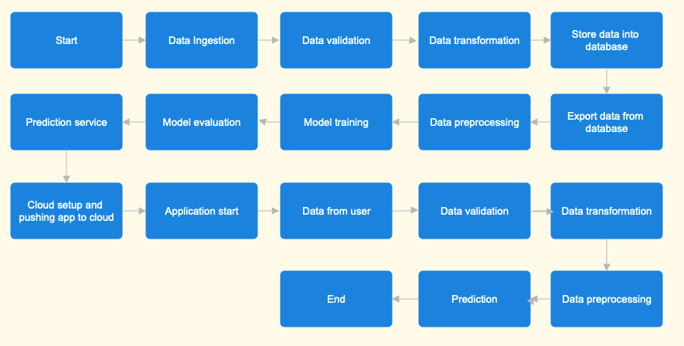
Architecture

Slide 5
Data Ingestion
Dataset is available at UCI Machine Learning Repository. Please refer here
Create artifacts/data_ingestion/data directory. Download and extract files to this directory.
Keep only CSV files to the directory and remove any other types of files

Slide 6
Data Validation and transformation
Row file name validation with respect to filename mentioned in config/config.yaml
Validate number of columns is 7 (6 molecular descriptors and 1 quantitative response)
Validating the data doesn't contain missing values in whole columns
If the validation is successful, the data is copied to artifacts/data_validation/traning_raw_files_validated
Otherwise the data is moved to bad data directory
Missing values (if exists) are substituted as Null

Slide 7
Database Operations
Create database table
Insert good data into table
Export data from table into CSV file. At the end of this stage, inputfile.csv is available at artifacts/training_file_from_db directory

Slide 8
Data Preprocessing
Load input data for training
Separate features and label
Dealing with null values / Imputing missing values
Dropping columns with zero std deviation
Perform standard scaling
Save preprocessed data. At the end of this stage, the preprocessed data is available in the artifacts/preprocessed_data directory

Slide 9
Model Training
Load input data for training
Perform Hyper parameter tuning for different machine learning algorithms such linear regression, support vector machine, decision tree and choose the model with best metrics
Save the best model in terms of performance metrics(r2_score and rmse)

Slide 10
Prediction Service
Input feature values from the user
Perform data preprocessing
Load the best model and predict the output
Display output to the user

Slide 11
Q & A
What is the source of data?
Data is available at UCI Machine Learning Repository. Please refer here
How logs are managed
Logging in maintained for each stage in the pipeline
What techniques are used for data preprocessing?
Imputing missing values with KNNImputer
Removal columns with Zero standard deviation
Perform standard scaling

Slide 12
Q & A (Continued)
How training was done or what models were used?
Hyper parameter tuning is performed with different machine learning algorithms such as linear regression, support vector machine, decision trees
Chosen the model that provide the best performance
How prediction was done?
The best model in terms of performance metric evaluation is stored
User input is received for all the features
Based on input features using best model, the corresponding prediction is made and displayed to the user

